Slide 1
Session 2
Working with SQL Server Database Objects
Faculty: Nguyen Ngoc Tu

Slide 2
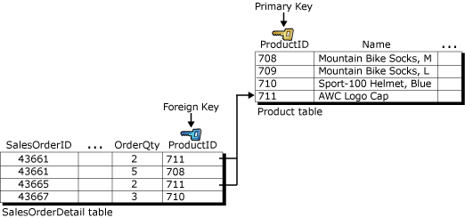
Review
Data integrity guarantees the quality of the data in the database.
Data integrity refers to maintaining the correctness and consistency of the data.
Data integrity falls into the following categories:
Entity integrity
Domain integrity
Referential integrity
User-defined integrity

Slide 3
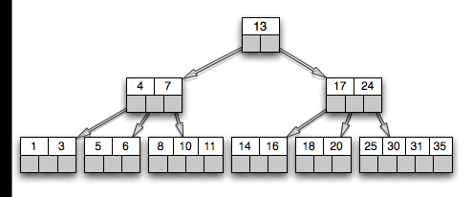
Review…
Explain to me what databases indexes are and how they work?
A database index is a data structure that improves the speed of operations on a database table
B-tree Indexes
Resource:http://20bits.com/articles/interview-questions-database-indexes/

Slide 4
Review…
Clustered Indexes
Non-clustered Indexes
XML Indexes

Slide 5
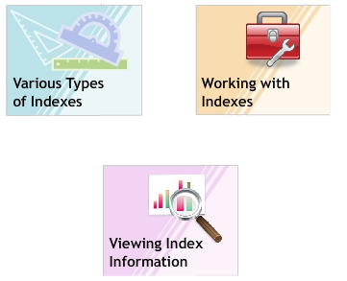

Topics
Types of Indexes
Maintaining Indexes

Slide 6
Types of Indexes
Module 3

Slide 7

Types of Indexes
Clustered index
In case of clustered indexes, table data is physically stored in order of keys.
There can be only one clustered index per table (?)
Clustered indexes are good for range searches.
A library, where books are arranged in sequence of Author names in the shelves
http://www.techfruits.com/2008/05/clustered-index-and-nonclustered-index.html
Example in library

Slide 8

Types of Indexes
Non-clustered Indexes
Non-clustered index does not physically rearrange the data in the database. (They just create pointers pointing to physical data rows)
There can be multiple non-clustered indexes per table. (SQL Server 2005 supports up to 249 non-clustered indexes on a table)
Non-clustered indexes are good for random searches.
What’ll happen if you want to request some books by its title?

Slide 9
Characteristics of Indexes
The characteristics of an index are based on the type and number of fields included in the index as well as the index options specified when creating the index.
Indexes can be classified as:
Unique Index
Composite Index
Full-Text Index
XML Index

Slide 10
Description Types of Indexes
Unique Index:
Unique Index can be defined on a column with no duplicate values.
If a table has a column with a PRIMARY KEY, a unique clustered index is automatically defined on that column.
If a table has a column with a UNIQUE constraint, then a unique non-clustered index is automatically created on that column.
Composite Index:
created on two or more columns. Both clustered and non-clustered indexes can be composite indexes.
Full-Text Index:
Allows complex queries to be performed on character data.
Using the Full-Text indexing feature, searches can be performed on individual words, two or more adjacent words, phrases, parts of words or inflectional words (such as drunk for drink).
XML Index:
Clustered and non-clustered XML index can be created on a column with XML data.

Slide 11
Index Design Guidelines
Indexes should be created based on the type of data, the amount of data present, the frequency of updates and the frequency of queries made on the table.
List of rules and guidelines:
An index can have a maximum of 16 columns.
Too many indexes decrease the performance of INSERT, UPDATE and DELETE statements.
Indexes should be used to improve query performance on tables with low update requirements but large volumes of data.
Maintain indexes even on small tables if data may later be added into the table.

Slide 12
Pragmatic Topics
Just do it!

Slide 13
Creating Indexes
There are two methods by which you can create an index:
Using the CREATE INDEX command of Transact-SQL.
Using the SQL Server Management Studio.

Slide 14
Using “CREATE INDEX”
Syntax:
CREATE INDEX <index_name>
ON <table_name> (<column_name>)
where
index_name: specifies the name of the index.
table_name: specifies the name of the table.
column_name: specifies the name of the column.
Example:
CREATE INDEX IX_Country ON Customer_Details(Country)

Slide 15
Creating Clustered Index
Syntax:
CREATE CLUSTERED INDEX index_name
ON <table_name> (<column_name>)
Example:
CREATE CLUSTERED INDEX IX_CustID
ON Customer_Details(CustID)

Slide 16
Creating Non-clustered Index
Syntax:
CREATE NONCLUSTERED INDEX index_name
ON <table_name> (<column_name>)
Example:
CREATE CLUSTERED INDEX IX_State
ON Customer_Details(State)

Slide 17
Creating Unique Index
Syntax:
CREATE UNIQUE INDEX index_name
ON <table_name> (<column_name>)
Example:
CREATE UNIQUE INDEX IX_CustID ON Customer_Details(CustID)

Slide 18
Creating Composite Index
Syntax:
CREATE INDEX index_name
ON <table_name> (<column_name> [ASC|DESC] [,…n])
Example:
CREATE UNIQUE INDEX IX_State_City ON Customer_Details(State,City)

Slide 19
FILLFACTOR
SQL Server 2005 provides the FILLFACTOR option to reserve space on the leaf page of an index for adding additional data at a later stage.
When an index is created or rebuilt, FILLFACTOR specifies the percentage of space on a page to be filled with data.
FILLFACTOR can be set to a percentage from 1 to 100.
The default FILLFACTOR value is 0.
FILLFACTOR of 100 is used only in read-only tables. In this case, no UPDATE or INSERT statements will occur.

Slide 20
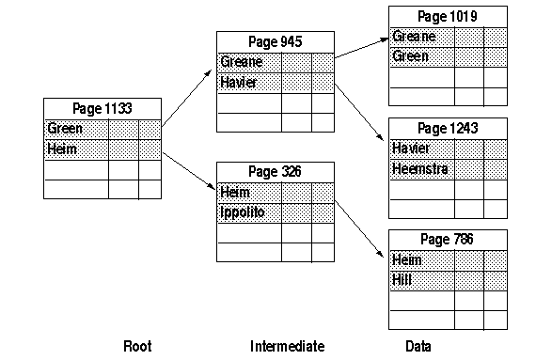
FILLFACTOR
Table and clustered index with fillfactor set to 50 percent
Resource:http://www.lcard.ru/~nail/sybase/perf/9076.htm

Slide 21
Create Index with Fill-factor option
Syntax:
CREATE INDEX index_name
ON <table_name> (<column_name>)
[WITH (FILLFACTOR = <fillfactor>)]
Example:
CREATE CLUSTERED INDEX IX_City ON Customer_Details(City)
WITH (FILLFACTOR=60)

Slide 22
PAD_INDEX
SQL Server 2005 provides the PAD_INDEX option to leave space vacant on a page vacant on a page in the intermediate level of the index for future growth.
If PAD_INDEX option is not specified or if it is set to OFF, then, by default, space for one row entry in the non-leaf-level pages is left vacant.
If the PAD_INDEX option is set to ON, then the space left vacant in the non-leaf-level pages is dependent on the value specified in the FILLFACTOR option.

Slide 23
Create Index with Pad index option
Syntax:
CREATE INDEX index_name
ON <table_name> (<column_name>)
[WITH (PAD_INDEX = {ON|OFF})]
Example:
CREATE CLUSTERED INDEX IX_TransID ON Account_Transactions(TransID)
WITH (PAD_INDEX = ON, FILLFACTOR = 80)

Slide 24
Viewing INDEX Information
SQL Server 2005 allows you to view all indexes defined on a table, the properties of an index, the space used by an index.
Two methods:
Using the sp_helpindex stored procedure.
Using the SQL Server Management Studio.

Slide 25
“sp_helpindex”
The sp_helpindex is a system stored procedure that can be used to view all of the indexes in a table.
Execution of the sp_helpindex returns the following information: name of the index, description of the index, column(s) that comprise the index expression.
Syntax: sp_helpindex ‘<object_name>’
Example:
EXEC sp_helpindex ‘Customer_Details’;

Slide 26
Summary 1
Indexes are of two types, clustered and non-clustered.
In a clustered index, data is physically sorted. Hence, a table can have only one clustered index.
In a non-clustered index, data is not physically sorted, only pointers are created to point to the physical location of the data. (Hence, a table can have multiple non-clustered indexes).

Slide 27
Summary 1 …
Indexes can be created using the CREATE INDEX command.
An index that uses more than one column to index data is called a composite index.
The FILLFACTOR and PAD_INDEX options reserve space on index pages for future index expansion.
The sp_helpindex system store procedure is used to view index information.

Slide 28
Maintaining Indexes
Module 4

Slide 29
Modifying an Index
Syntax:
ALTER INDEX <index_name> ON <table_name>
{ REBUILD
[WITH (PAD_INDEX = { ON | OFF }
| FILLFACTOR = fillfactor)]
| DISABLE | REORGANIZE }
[ ; ]
where,
REBUILD: specifies that the index will be rebuilt using the same columns, index type, uniqueness attribute and sort order.
DISABLE: specifies that the index will be disabled.
REORGANIZE: specifies that the leaf level pages of the index will be reorganized

Slide 30
SQL Statements for Online Index Operations
You can modify and query the data in the tables during index operations only if the ONLINE option is set to ON.
CREATE INDEX <index_name> ON <table_name> (<column_name> [,…n]) WITH (ONLINE = {ON|OFF})
ALTER INDEX <index_name> ON <table_name> REBUILD WITH (ONLINE = {ON|OFF})
DROP INDEX <index_name> ON <table_name> WITH (ONLINE = {ON|OFF})
ALTER TABLE <table_name> DROP CONSTRAINT <constraint_name> WITH (ONLINE = {ON|OFF})

Slide 31
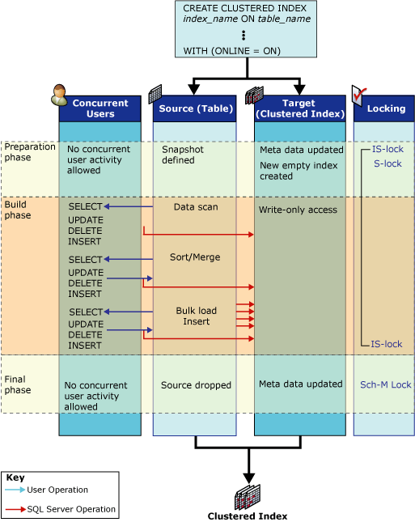
Image Resource: http://technet.microsoft.com/en-us/library/ms191261.aspx

Slide 32
Parallel Index Operations
Parallel Index Operation is a new feature available only in SQL Server 2005 Enterprise Edition.
Syntax:
CREATE INDEX <index_name> ON <table_name>(<column_name>)
WITH (MAXDOP = max_degree_of_parallelism)
where,
max_degree_of_parallelism: specifies the number of processors used for parallel index operations.
Example:
CREATE INDEX IX_City ON Employee_Details (City) WITH (MAXDOP = 2)

Slide 33
The “Max Degree of Parallelism” Option
The number of processors that can be used for executing each index statement is determined by max_degree_of_parallelism configuration option in SQL Server 2005.
The valid integer values for this option range from 0 to 64.
If the system is busy, the max_degree_of_parallelism is reduced automatically before the index statement is executed.

Slide 34
The “Max Degree of Parallelism” Option
Valid Value | Description
0 | Uses all available processors for each index statement. It is the default value.
1 | Stops parallel execution. The index statements execute serially.
2-64 | Restricts the number of processors used to the value specified

Slide 35
Basics of Locking
SQL Server 2005 provides a feature to prevent multiple users from simultaneously updating the same data.
Various resources in SQL Server 2005 can be depending on individual updating requirements. The levels at which locks are applied is referred to as lock granularity.
In SQL Server 2005, lock granularity can be at the following levels: Row, Table, Page, Database.

Slide 36
Indexes with Included Columns
Example:
CREATE NONCLUSTERED INDEX IX_Customer_AccNo
ON Customer_Details(AccNo) INCLUDE (Address, City, State)
The following query will use the index, IX_Customer_AccNo.
SELECT Address, City, State, AccNo
FROM Customer_Details
WHERE AccNo BETWEEN 5100 AND 6900
The data type such as text, ntext and image are not allowed in indexes with included columns.

Slide 37
Benefits
The index size can be increased beyond 16 columns.
The index covers a wider range of data types.
The index is more efficient and provides better performance.

Slide 38
Reorganizing an Index
The ALTER INDEX statement with the REORGANIZE keyword allows you to reorganize an index. You can also include the PARTITION option with the ALTER INDEX statement to reorganize a single partition of the index.
Syntax:
ALTER INDEX <index_name> ON <table_name> REORGANIZE
Example:
ALTER INDEX IX_City ON Customer_Details REORGANIZE

Slide 39
Rebuilding an Index
The rebuild operation on an index creates an index with the same name, columns and sort order of the columns as the original index. Also, the rebuild operation ensures that the information in the index is sorted during the rebuilding process.
ALTER INDEX with REBUILD
Syntax:
ALTER INDEX <index_name> ON <table_name> REBUILD
Example:
ALTER INDEX IX_City ON Customer_Details REBUILD

Slide 40
Disabling an Index
Disabling an index restricts users from accessing the index using the ALTER INDEX statement. Also, the REBUILD option in this statement enables the disabled index.
If you disable a clustered index on a table, user access to the data in the table is restricted but information in the index is not removed.
When an SQL Server is upgraded to a new release, indexes defined on tables are automatically disabled. The SQL Server displays a message showing index names and constraints associated with the index. You can use this information to rebuild the index after the upgrade process is complete.

Slide 41
Dropping an Index
Syntax:
DROP INDEX <index_name> ON <object>
Example:
DROP INDEX IX_City ON Customer_Details

Slide 42
Index Statistics
Index statistics provides information about the distribution of values in a column or a group of columns. The query optimizer uses index statistics to speed up the query process.
SQL Server 2005 creates a histogram of the statistical information of an index. It gives information about the number of records in each interval, the density of records in each interval and the number of duplicate values in each interval.

Slide 43
Index Statistics
CREATE STATICTICS
Syntax:
CREATE STATICTICS <statictics_name>
ON <table_name> (column_name)
Example:
CREATE STATICTICS Stats_Customer
ON Customer_Details(CustID)

Slide 44
Summary
New index features: online index operations, parallel index operations and locking options.
The ALTER INDEX statement is used to reorganize, disable and rebuild an index.
SQL Server 2005 allows non-key columns to be included in non-clustered indexes and allows you to create XML indexes on the XML columns in the table.
The various methods to optimize indexes include reorganizing, rebuilding, disabling and dropping indexes.
SQL Server 2005 creates index statistics that provide information about the distribution of values in a column or a group of columns. This information is used by the query optimizer to speed up the query process.

